Slide 1
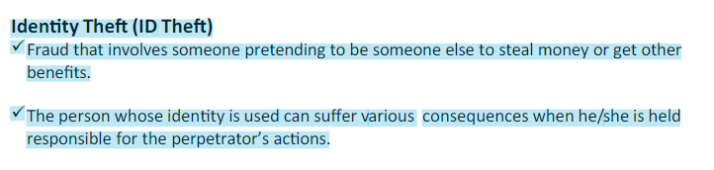

Slide 2
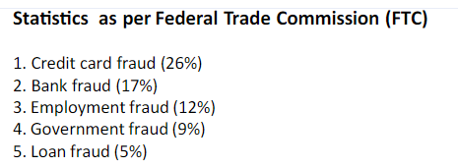

Slide 3
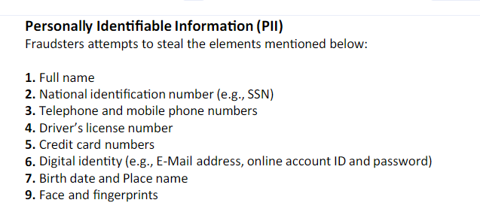

Slide 4
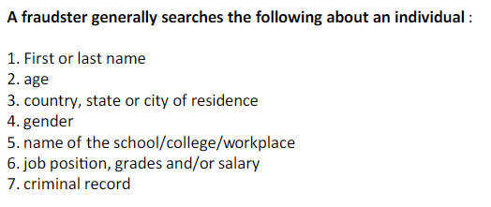

Slide 5
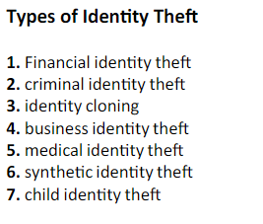

Slide 6
Financial identity theft:
The victim's name and Social security number (SSN) are used to apply for telephone service, credit cards, or loans, and to buy merchandise or lease cars or apartments (Using another's identity to obtain goods and services). It is consist of:
New account fraud: The perpetrator uses the victim's information to open new credit accounts.
Existing account fraud: This type of identity theft involves using stolen information to access one or more of the victim's existing accounts

Slide 7
Criminal identity theft or Falsely Misrepresent:
The victim's name, address, and other personal details are given to law-enforcement officials during the commission of a crime. The victim is then mistakenly arrested. In the other word it is posing as another when arrested for a crime.

Slide 8
Identity cloning:
The victim’s private information is used by an imposter to establish a new life, complete with necessary cards, permits and papers.

Slide 9
Business identity theft:
Credit cards and bank accounts are opened in the name of a business and are then used to order merchandise or acquire loans. In the other word it is using another's business name to obtain credit.

Slide 10
Medical identity theft:
Happens when the pretender uses another individual's personal information for connecting to medical service. By this way abusing from insurance could be done easily

Slide 11
Synthetic identity theft:
Which a theft by steeling personal identifying information from different sources and by inventing with fictitious information, create a new and false identity

Slide 12
Child identity theft:
Parents might some times steal their children’s identity to open credit card accounts. Utility accounts, bank accounts and even to take out loans or secure leases because their own credit history is insufficient or too damaged to open such accounts.

Slide 13


Slide 14
1. Human-based methods: These methods are techniques used by an attacker without and/or minimal use of technology
Direct access to information: People who have earned a certain degree of trust (house cleaners, babysitters, nurses, friends or roommates) can obtain legitimate access to a business or to a residence to steal the required personal information.
Dumpster diving: Retrieving documents from trash.

Slide 15
Theft of a purse or wallet: Wallet often contains bank credit cards, debit cards, driving license, medical insurance identity card and what not. Pickpockets work on the street as well as in public, transport and exercise rooms to steal the wallets and in turn sell the personal information.
Mail theft and rerouting: It is easy to steal the postal mails from mailboxes, which has poor security mechanism and all the documents available to the fraudster are free of charge.

Slide 16
Shoulder surfing: People who loiter around in the public facilities such as in the cybercafes, near ATMs and telephone booths can keep an eye to grab the personal details.
False or disguised ATMs ("skimming"): Just as it is possible to imitate a bank ATM, it is also possible to install miniaturized equipment on a valid ATM. This equipment (a copier) captures the card information, using which, duplicate card can be made and personal identification number (PIN) can be obtained by stealing the camera films.

Slide 17
Dishonest or mistreated employees: An employee or partner with access to the personal files, salary information, insurance files or bank information can gather all sorts of confidential information and can use it to provide sufficient damage.
Telemarketing and fake phone calls.

Slide 18
2. Computer-based technique: These techniques are attempts made by the attacker to exploit the vulnerabilities within existing processes and/or systems.
Backup theft: This is the most common method. In addition to stealing equipment from private buildings, attackers also strike public facilities such as transport areas, hotels and recreation centers. They carefully analyze stolen equipment or backups to recover the data.

Slide 19
Hacking, unauthorized access to systems and database theft: Besides stealing the equipment and/or hardware, criminals attempt to compromise information systems with various tools, techniques and methods, to gain unauthorized access, to download the required information.
Phishing
Pharming
Redirectors: These are malicious programs that redirect users' network traffic to locations they did not intend to visit.

